Slide 1



A Framework for Image Dark Data Assessment
Yu Liu†, Yangtao Wang†, Ke Zhou†, Yujuan Yang†, Yifei Liu†, Jingkuan Song§, and Zhili Xiao‡
†Huazhong University of Science and Technology, Wuhan, China
§University of Electronic Science and Technology of China, Chengdu, China
‡Tencent. Inc
Yu Liu
1/8/2019, Chengdu, China
Notes:
Good afternoon everyone, thank you for your attention. My name is Liuyu who comes from Huazhong university of Science and Technology. My report’s name is A Framework for Image Dark Data Assessment.

Slide 2
Outline
Background
Motivation
Design Overview
Methodology
Experiment Results
Conclusion
Notes:
Maybe this is the first time you've heard of dark data. I will introduce its conception in the background.

Slide 3

Background
Image dark data, whose content and value are not clear, consistently occupy the storage space but hardly produce great value.
Image dark data are ubiquitous and have brought economic costs to enterprises. For example, many social platforms store image data (i.e., albums and chat images) as an independent resource separated from other businesses. Many of them are not visited twice.
Image dark data
Notes:
Image dark data, whose content and value are not clear, consistently occupy the storage space but hardly produce great value. They are ubiquitous and have brought economic costs to enterprises. For example, many social platforms store image data (i.e. albums and chat images) as an independent resource separated from other businesses. Many of them are not visited twice.

Slide 4


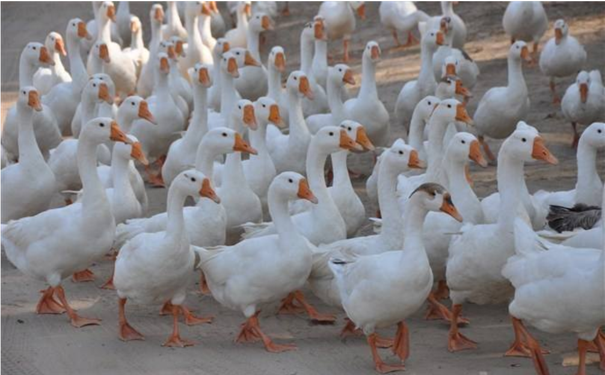
Background
I want a goose
I want gold
or
I want to go out
You need light in the dark!
Notes:
Facing with the dark data, it's like standing in front of a dark room. I want a goose? I want gold or I want to go out. There are just many requirements but no one can give you response. You need light in the dark.
O, who want a goose, you win.

Slide 5
Outline
Background
Motivation
Design Overview
Methodology
Experiment Results
Conclusion
Notes:
Let us see the motivation

Slide 6
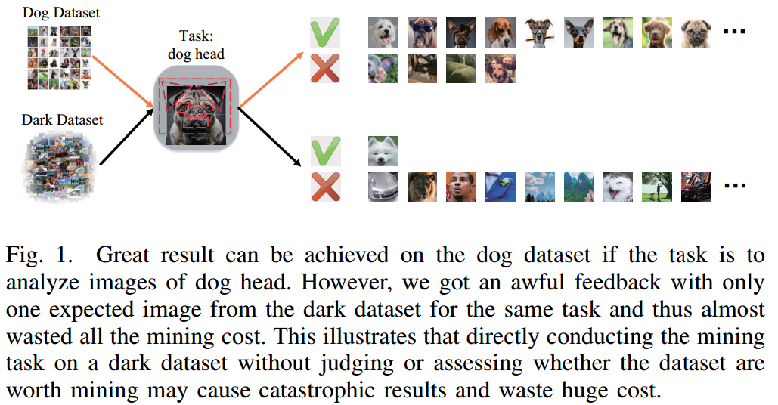
Motivation
Therefore, it is of great significance to assess the dark data before data mining to help the user reduce waste.
Notes:
In practice, dark data is harm to our data science. For example, when we want to search dog head, we can acquire a lot of satisfactory results on dog dataset. However, on some dark data, this mining may be just waste time.
Therefore, it is of great significance to assess the dark data before mining to help the user reduce waste.

Slide 7
Motivation
Challenges
First, the similarity between images must be objectively measured under a unified standard to help the user understand the evaluation values of dark data.
Second, it is important to capture semantic features with generalization ability.
Third, it is challenging to design an efficient assessment scheme to support large-scale datasets.
Notes:
Of course, it is not easy to complete this assessment. When we started this project, we encountered three challenges.
First, how to give an objective method to measure the similarity between one image and whole data.
Second, how to capture semantic features with generalization ability.
Third, how to design the scheme to satisfy efficiency in large-scale scenarios.

Slide 8
Outline
Background
Motivation
Design Overview
Methodology
Experiment Results
Conclusion
Notes:
Therefore, we design a framework to deal with them.

Slide 9
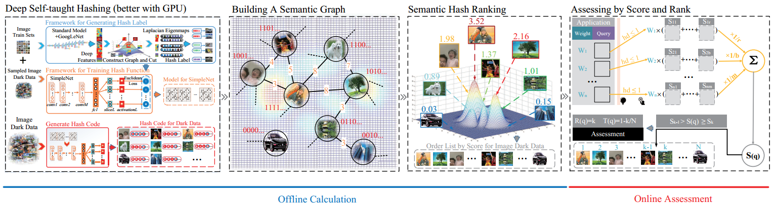
Design Overview
Step 1: Map unlabeled images into semantic hash codes.
Step 2: Build semantic Hamming Graph.
Step 3: Calculate global semantic importance score (rank) for each image (node).
Step 4: Assess the user query for a given task.
Notes:
This framework has 3 offline steps and 1 online step. Step 1: We train and use the deep model to map the images into similarity hash codes. The method is DSTH. Step 2: we build a graph with the hash code. The hamming distance is the weight on the link. Step 3: we calculate global importance score for each image. The method is SHR. Step 4: we assess the dark data online by the user’s requirement.

Slide 10
Outline
Background
Motivation
Design Overview
Methodology
Experiment Results
Conclusion
Notes:
Let us see the details.

Slide 11
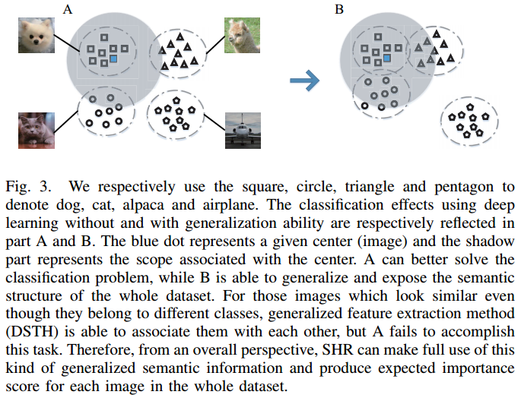
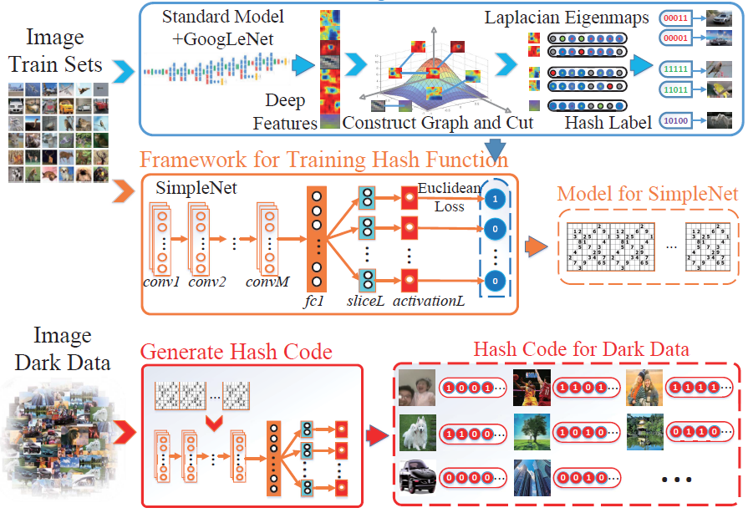
Deep Self-Taught Hashing
Methodology
Notes:
We first use the deep self-taught hash algorithm to generate hash model and hash code. This method generates hash labels by deep features and graph embedding method in the first step. At the second step, it learns a model with those labels in deep framework. It has advantage of deep learning and zero-shot hashing. The generalization ability of this method makes it applicable to real-world scenarios.
Look at the example at top right. We respectively use the square, circle, triangle and pentagon to denote dog, cat, alpaca and airplane. The classification effects using deep learning without and with generalization ability are respectively reflected in part A and B. The blue dot represents a given center and the shadow classification problem, while B is able to generalize and expose the semantic structure of the whole dataset. For those images which look similar even though they belong to different classes, generalized feature extraction method is able to associate them with each other, but A fails to accomplish this task. Therefore, from an overall perspective, SHR can make full use of this kind of generalized semantic information and produce expected importance score for each image in the whole dataset.

Slide 12
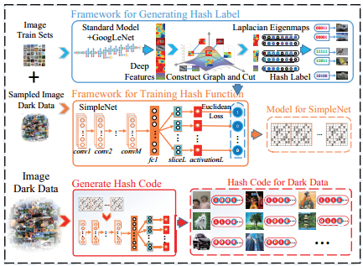
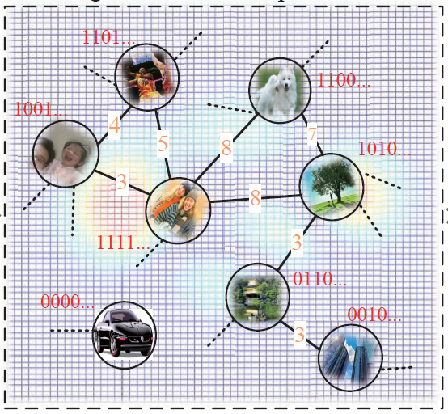
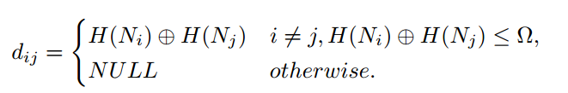
Building a Semantic Graph with Restricted Hamming Distance
Methodology
Notes:
Second, we construct the graph with these hash codes. For improving the efficiency, we only connect the nodes whose distance smaller than half of length of the hash code on the graph. We call it restricted hamming distance.

Slide 13
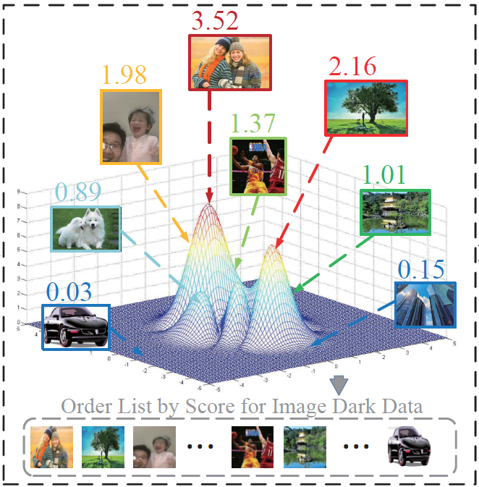
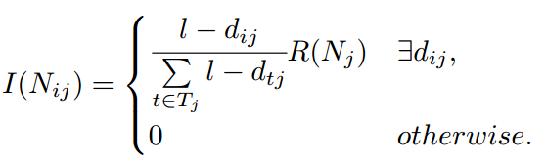
Semantic Hash Rank（SHR）
Methodology
We propose SHR algorithm which takes both the number of connected links and the weight on edges into consideration.
Notes:
Next, we use semantic hash rank algorithm to compute importance score for each node. This random walk is achieved on restricted hamming distance. The detail will be shown on the following report by doctor Yangtao Wang.

Slide 14
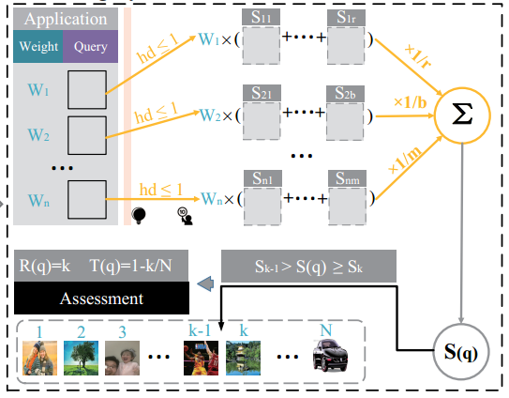
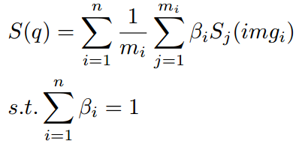
Assessment by Query Score and Rank
Methodology
The user can decide whether the image dark data are worth mining for the query according to returned query score.
Notes:
Ok, on the final step, we will complete the assessment. The user’s requirement will be expressed by images. Each image will get a retrieval result in predefined range. Averaging their scores of retrieval results, we can acquire rank of the requirement and give assessment conclusion. Obviously, The higher the rank, the more worthwhile the requirement is to be implemented.

Slide 15
Outline
Background
Motivation
Design Overview
Methodology
Experiment Results
Conclusion
Notes:
Next, we will show our experimental results.

Slide 16
Experimental Results
Datasets: CIFAR-10 dataset
real-world dataset
large-scale Tencent dataset
Experimental Procedures:
Generality ability of DSTH
Efficiency of graph building using hash codes
Semantic extraction of SHR
Assessment result of our framework
Notes:
We select three different datasets and design different verifications.

Slide 17

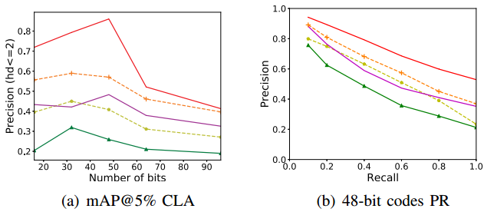
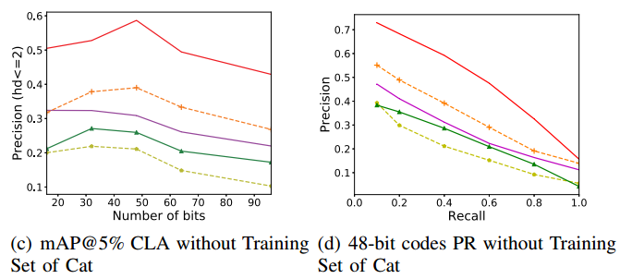
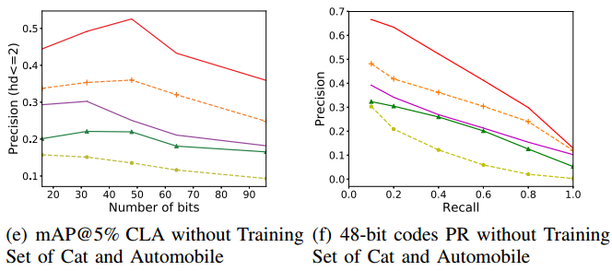
Experimental Results
1. Generality ability of DSTH
DSTH yields a significant dominance in term of precision with 48-bit codes.
Notes:
These results show the generalization ability of the dsth. It is easy to find that dsth has better performance on precision-recall curve and mAP@5%, because it can calculate the distance of unseen samples more accurately.

Slide 18
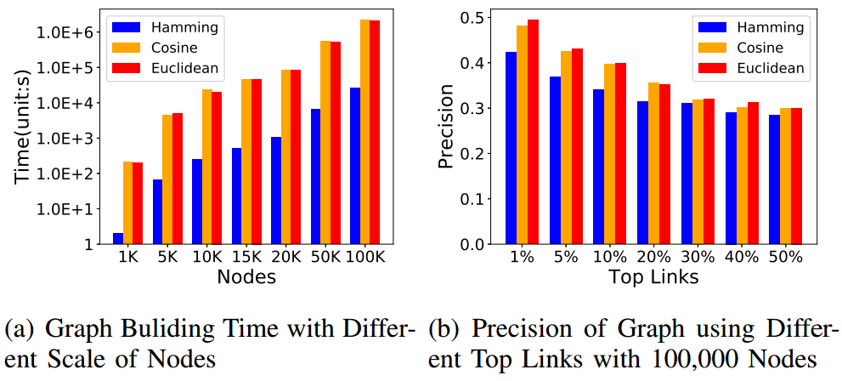
Experimental Results
2. Efficiency of graph building using hash codes
On the whole, there is not a marked difference of precision between three metrics, although hashing will bring certain loss to precision. However, Hamming distance has overwhelming predominance in building a graph in term of time cost.
Notes:
These results show the efficiency of graph building using hash codes. It is easy to find that hamming distance has overwhelming predominance in term of time cost although it brings a certain loss to precision.

Slide 19
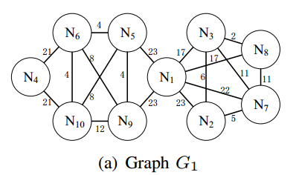
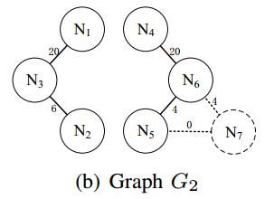
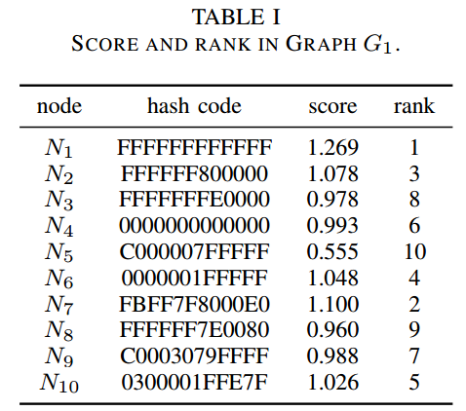
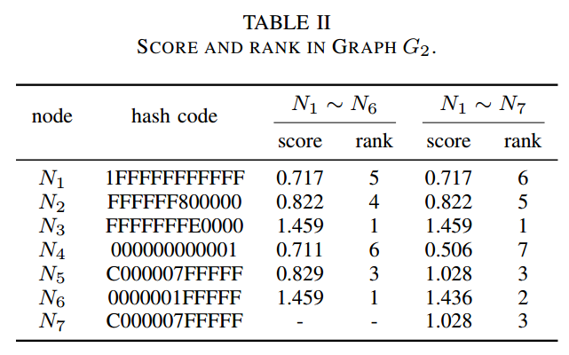
Experimental Results
3.1. Semantic extraction of SHR on hash graphs
Those nodes who own more number of links with lower weights will get higher score and rank.
Notes:
These results show the nodes who own more number of links with lower weights will get higher score and rank using SHR. The calculation with insert and deletion will be shown in the following report by Doctor Yangtao Wang.

Slide 20
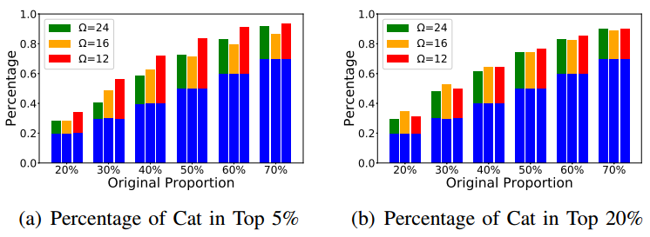
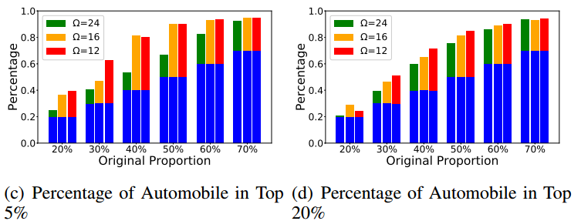
Experimental Results
3.2. Semantic extraction of SHR on CIFAR-10
SHR effectively highlights and preposes the data whose semantic information account for higher proportion in original data set after ranking.
Notes:
These results show our algorithm can preposes the data whose semantic information account for higher proportion in original data set after ranking. The blue length is original rate, the above other color length is highlighted by SHR.

Slide 21
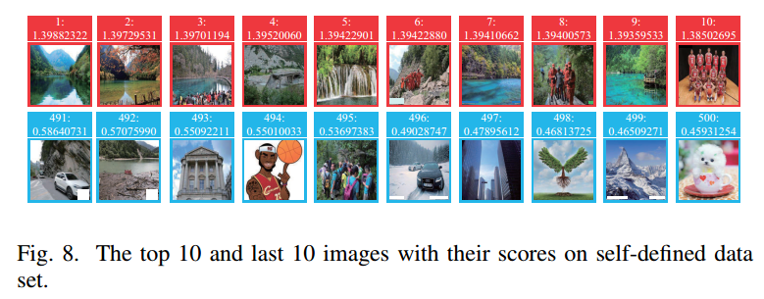
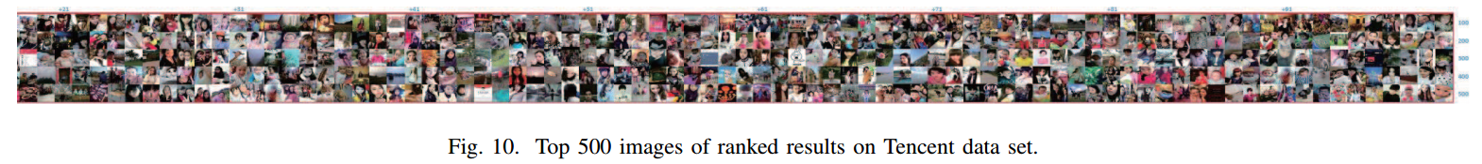
Experimental Results
3.3. Semantic extraction of SHR on real-word and Tencent datasets
Notes:
These results show our algorithm can reveal hot semantic in the real-world data set. Especially in the Tencent data set which is the real dark data for everyone, we find that the main content is children and female.

Slide 22
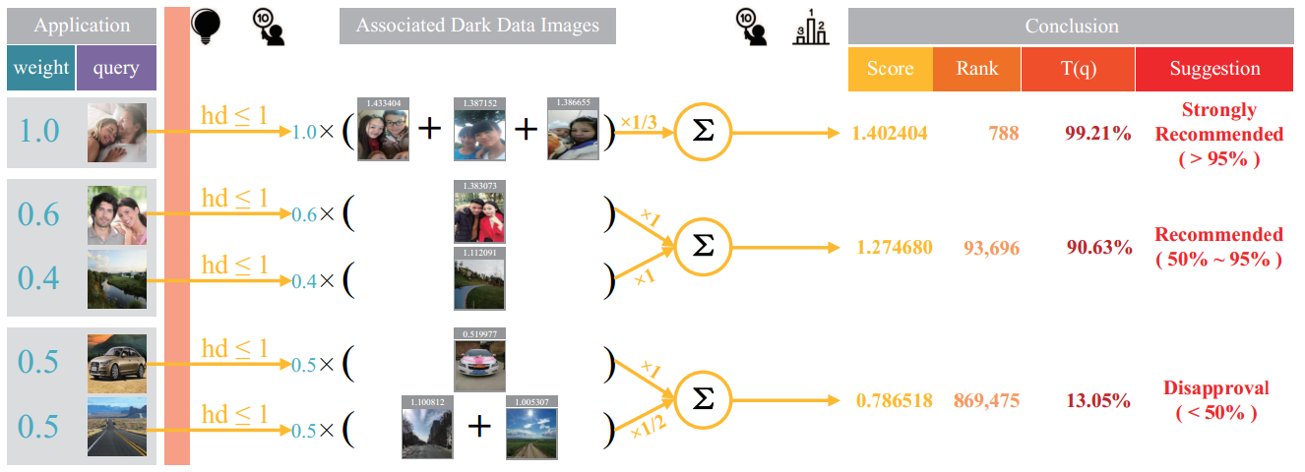
Experimental Results
4. Assessment on Tencent dataset
Notes:
Finally, these results show the assessment on the Tencent dataset by different requirements.
For the first requirement, we get 3 photos with high scores, our framework gives strong recommendation according to the high rank.
Meanwhile, for the last requirement, we also get 3 photos, but they have low scores, our framework gives the advice of disapproval according to the low rank.
It is easy to find that Tencent dataset is fit for mining photos depicted people but not fit for car.

Slide 23
Outline
Background
Motivation
Design Overview
Methodology
Experiment Results
Conclusion
Notes:
Ok, let us see the conclusion

Slide 24
Conclusion
We propose a framework for image dark data assessment for the first time.
We design SHR algorithm to calculate global semantic score for each image.
We design an effective assessment for the user query.
Experimental results on real-world datasets show our framework can apply to large-scale datasets, help the user cognize dark data, and assist the user to conduct subsequent data mining work.
Notes:
To the best of our knowledge it is the first assessment framework for dark data. Thank APWEB-WAIN for giving us opportunity to manifest this research. We hope more researchers could participate in this study.

Slide 25
Thank You!
Contact me:
liu_yu@hust.edu.cn
Notes:
Thank you for your attention

